Slide 1
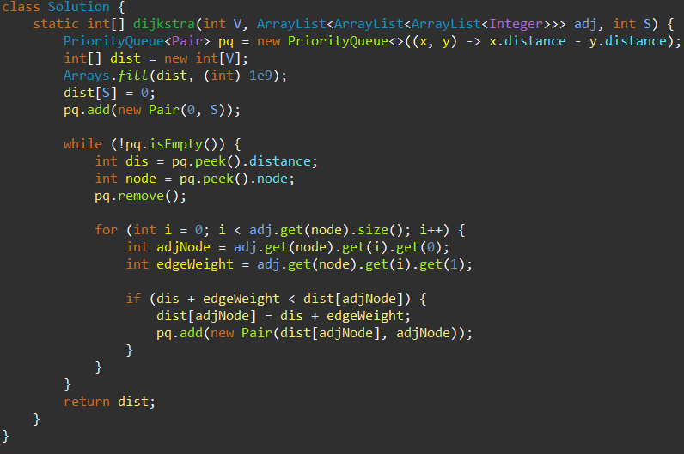
Dijkstra’s Algorithm
Dijkstra's algorithm is designed to find the shortest path from a starting node (or source) to all other nodes in a weighted graph, where all edge weights are non-negative.

Slide 2
Real-Life Applications of Dijkstra Algorithm
Network Routing
GPS and Navigation systems
Pathfinding in Games and Robotics
Used in computer networks to find the most efficient routes for data transfer.
Determines the quickest route between two geographical points.
Determines the quickest route between two geographical points.

Slide 3
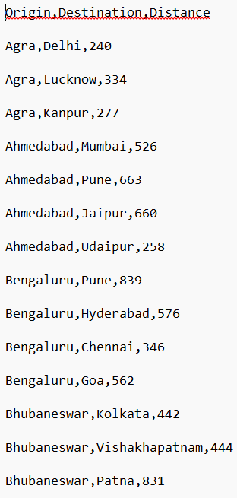
Data set:Distances
The data set is in .txt format and it has distances form one place to the other.
Our motive is to first read the file,and give an index to all the unique tokens.
After that,using the algorithm,we will find the shortest distance from source node
to other nodes and output the result in a .txt file.
The dataset is in this format as shown in the screenshot->

Slide 4
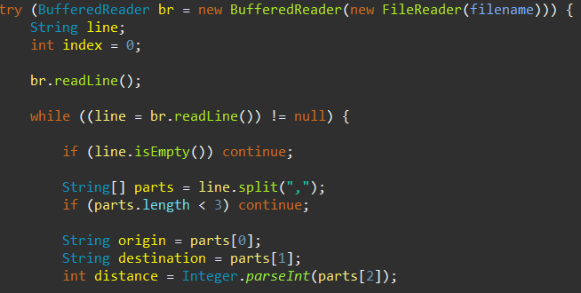
1.BufferedReader is used to read the dataset file. The readCitiesDataset function reads the file line by line using br.readLine()
2. br.readLine(); reads the first line, typically the header of the dataset, and skips it.
3. The while ((line = br.readLine()) != null) loop reads each subsequent line until the end of the file is reached
4.The line.split(“,”) splits the line into multiple tokens which which are stored in an array of string, parts.
5.Here,”,” is the delimeter.
6.We use BufferedReader,because it is more efficient to read files that have large data.

Slide 5
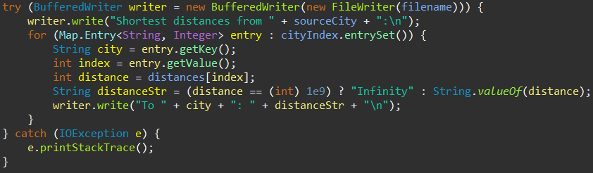
1.A BufferedWriter is created,which is wrapped around a FileWriter ,to write data to a specific file(filename).
2.The line writer.write("Shortest distances from " + sourceCity + ":\n"); writes a header to the file indicating the
Source city.
3.Each line in the file indicates the city name and its distance from the source city in the format To[city]:[distance].
4.The catch block catches any IOException that may occur during file writing and prints the stack trace to help debug the issue.

Slide 6
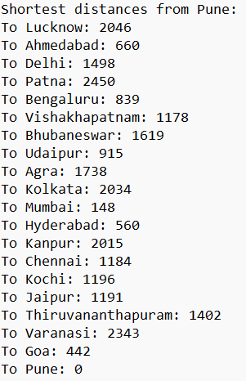
This is the output .txt file that gives the shortest distance from source city to all the other cities.

